Slide 1
XAI for GNNs

Slide 2
Overview
What is explainable AI?
Motivation for explainable AI (XAI)
XAI methods for tabular, image, text data
XAI methods for graphs
XAI in PyG

Slide 3
What is explainable AI (XAI)?

Slide 4
What is explainability?
“… the ability to explain or to present in understandable terms to a human” (Doshi-Velez & Kim 2017)
“descriptions are diverse … refers to more than one concept” (Lipton 2016)
There is no single definition
Attempts to quantify explainability require subjective decisions on desiderata and measurement

Slide 5
What is eXplainable Artificial Intelligence (XAI)
An emerging (or maybe resurgent) research area in AI
Goal is to develop knowledge and methods that can be used to “explain”:
How AI systems arrive at specific solutions
Which features most influenced a given output
Which and how features interact
Operating characteristics
Model biases
Accuracy relative to input regions
How the model learned

Slide 6
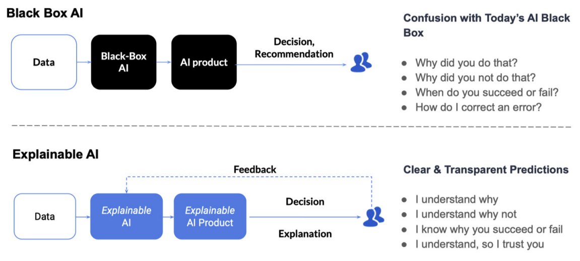
What is explainable AI?

Slide 7
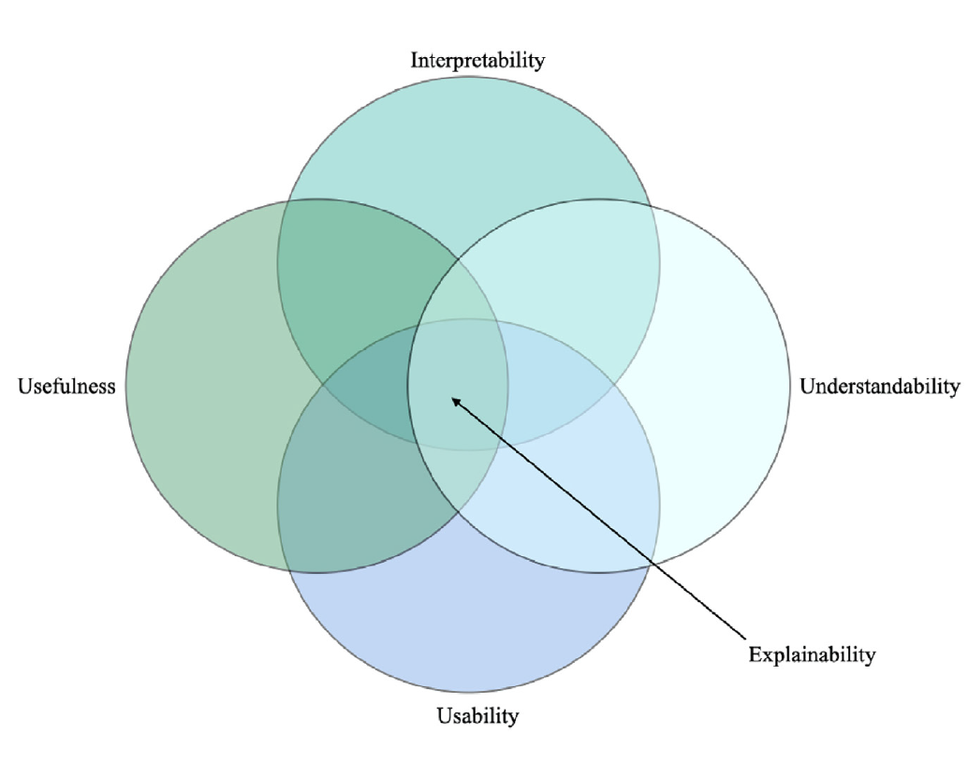
What makes an AI explainable?
No consensus definition but most researchers agree explainability is a construct encompassing several concepts including:
Interpretability – degree to which a human can infer the cause of and predict a model output
Understandability – degree to which a user can determine how the system works
Usability – the ease with which a user can operate the AI
Utility – the practical usefulness of the AI
Figure credit: Combi, Carlo, et al. "A manifesto on explainability for artificial intelligence in medicine." Artificial Intelligence in Medicine 133 (2022): 102423.

Slide 8
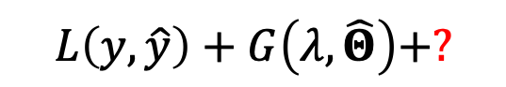
Why do we need special methods for explainability?
Arises when learning objectives fail to capture other real-world desiderata
Prediction Loss
Objective Function Limitations
Difficult to formalize many real-world desiderata in mathematical form
For example, how would one form an objective to encode ”trust” or “fairness”
$$L\left(y,\hat{y}\right)+G\left(λ,\hat{Θ}\right)+?$$
Regularization

Slide 9
Motivation for XAI

Slide 10
Auditing for high-stakes decision
Many real-world applications can lead to biased decisions that potentially cause serious harm
Criminal justice

Slide 11


Auditing for high-stakes decision
Many real-world applications can lead to biased decisions that potentially cause serious harm
Criminal justice
Only 20% of people considered at risk of recidivism ended committing a new crime

Slide 12
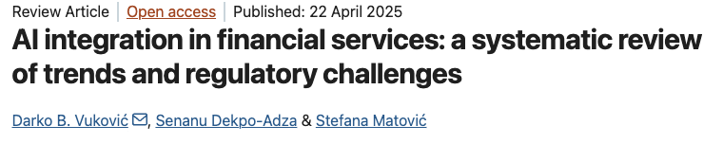

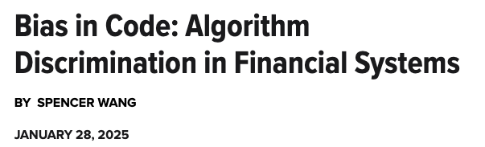
Auditing for high-stakes decision
Many real-world applications can lead to biased decisions that potentially cause serious harm
Finance

Slide 13


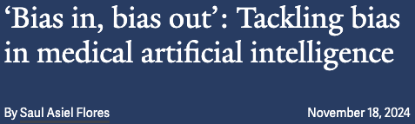
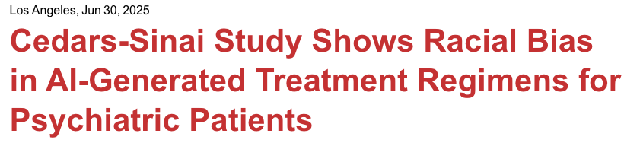
Auditing for high-stakes decision
Many real-world applications can lead to biased decisions that potentially cause serious harm
Healthcare

Slide 14
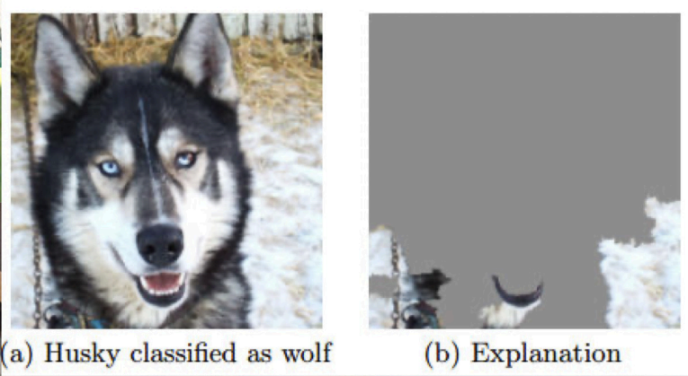
Model error analysis
Explanations can help identify patterns in model errors
Background bias: Model predictions of object classification can be influenced by the background. Here, the model predicts wolf because of snow in the background.

Slide 15
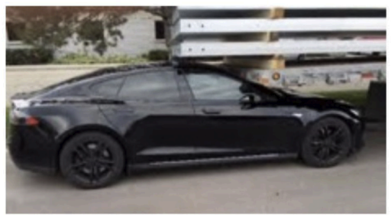
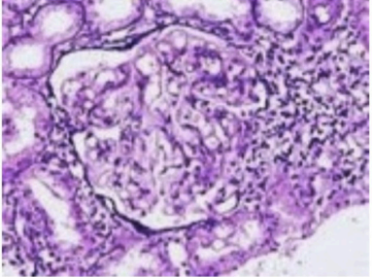
Model error analysis
Explanations can support model verification and risks
Which scenarios pose risks to autonomous vehicle systems?
Under what conditions might AI misdiagnose a disease?

Slide 16
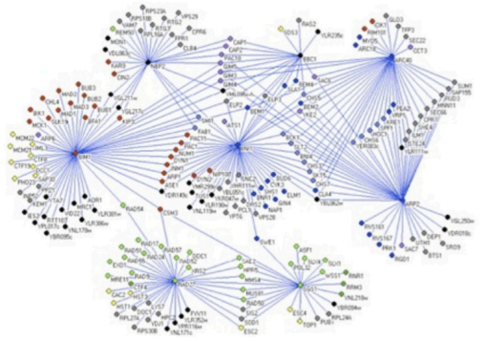
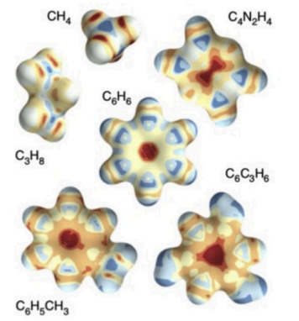
Generate new scientific insights
Explanations patterns can help us learn about physical, biological, and chemical mechanisms
Which genes unexpectedly appear in disease diagnosis explanations?
Which chemical structures explain reaction properties?

Slide 17
XAI methods for tabular, image, text data

Slide 18
Factual explanations
Explanations in the form of features that most affect the model output
Also referred to as feature importance methods
Most common form of XAI
Global explanation: independent of input sample
Local explanation:
depends on input sample
Local explanation: x₁ is more important here …
Global explanation: x₁ and x₂ equally important
x₂
Local explanation: x₂ is more important here
x₁
Notes:
Global explanations of feature importance identify features and their level of importance relative to the entire learned data distribution
Here, globally, we see x1 and x2 are approximately of equal importance
But if we examine feature importance locally, we may find that one feature is more important than the other

Slide 19

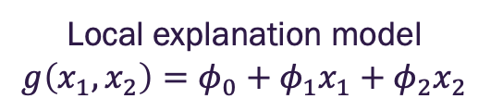
Local feature importance via additive feature attribution
Global model: $f\left(x_{1},x_{2}\right)=class$
Shapley Additive exPlanation (SHAP)
x₂
Local explanation model
$$g\left(x_{1},x_{2}\right)=φ_{0}+{φ_{1}x}_{1}+{φ_{2}x}_{2}$$
x₁
x₁ , x₂
importance
Notes:
Class of feature importance methods known as Additive Feature Attribution methods
Essentially, the goal is to develop a local linear model that approximates the black box model in a region containing the test sample
This local model will depend on the same or a set of transferred, but interpretable, inputs as the original model and include weights that indicate the importance of these features

Slide 20
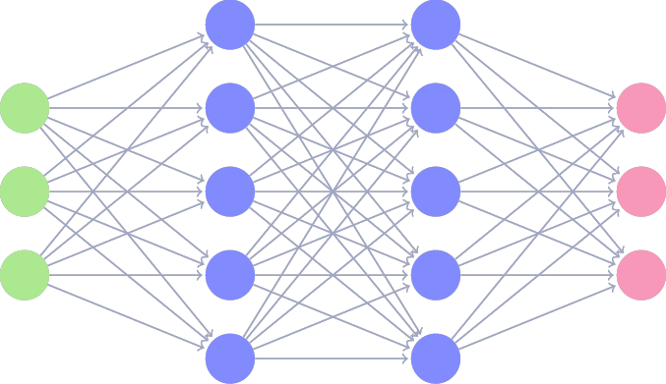
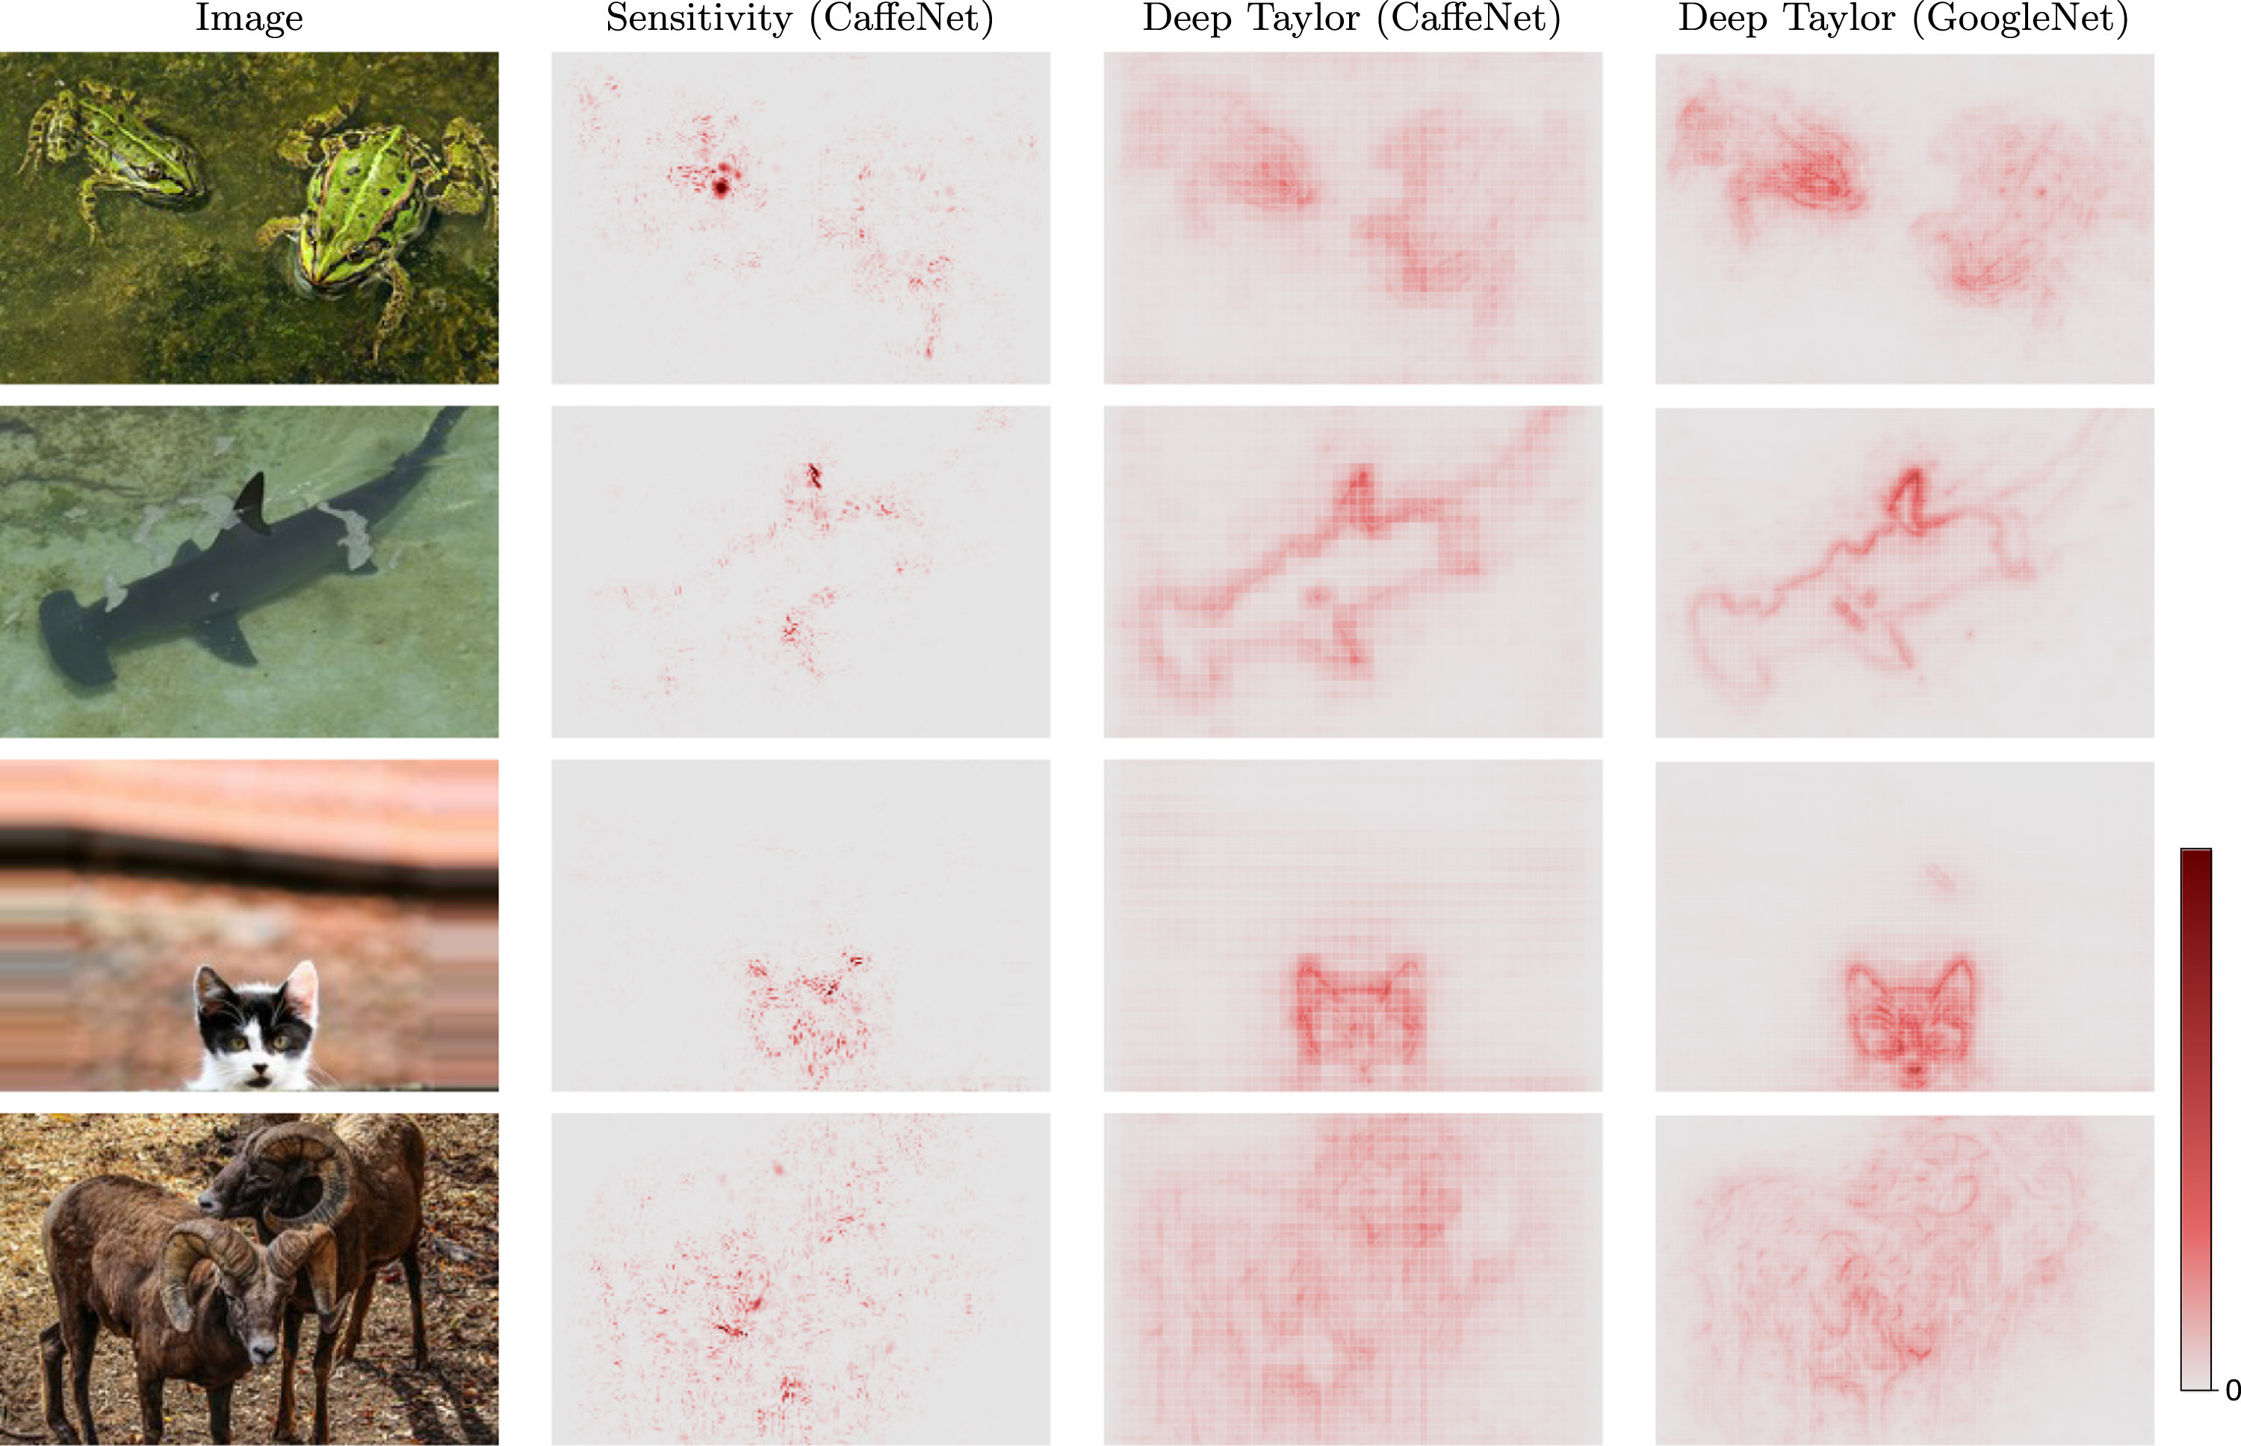

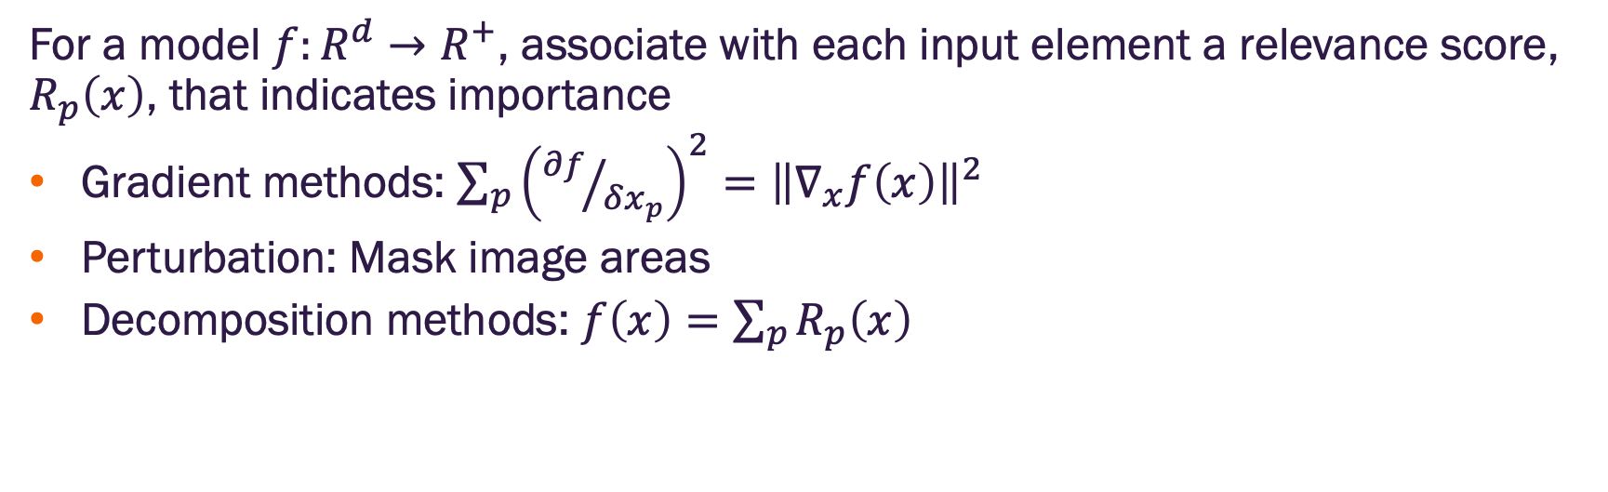
Visualization local feature importance methods
For a model $f:R^{d}→R^{+}$, associate with each input element a relevance score, $R_{p}\left(x\right)$, that indicates importance
Gradient methods: $\sum_{p}{{\left({∂f}/{δx_{p}}\right)}^{2}={\left\|∇_{x}f\left(x\right)\right\|}^{2}}$
Perturbation: Mask image areas
Decomposition methods: $f\left(x\right)=\sum_{p}{R_{p}\left(x\right)}$
Input
Model
Interpreter
Explanation

Slide 21
Instance based explanations with influence functions
Robust statistical methods that identify the training example(s) that most influence the current prediction
Deletion diagnostics (linear models)
Influence functions (twice differentiable loss function)
Useful in model development as a means of identifying outliers with undue influence on predictions
For deployed models can be used to indicate how important features of test sample compare to influential samples

Slide 22
XAI methods for graphs

Slide 23
Challenges for GNN explainability
Graphs contain input node feature and structure (topology) information
Existing XAI methods do not apply to discrete valued inputs (i.e., adjacency matrices)
For some graphs, only the structure information is important (nodes may not have any features). How should structural be used for explanations?
For node classification, how should neighbor nodes be used in explanations?
Domain specific knowledge may be necessary for explanations.
Ex: Explaining predictions on molecular graphs may require different methods than on citation networks.

Slide 24
Overview of GNN XAI methods
Different XAI methods focus on different aspects of graph models
Most answer a few questions:
Which input edges are most important?
Which input nodes are most important?
Which node features are most important?
What subgraphs are most important?

Slide 25
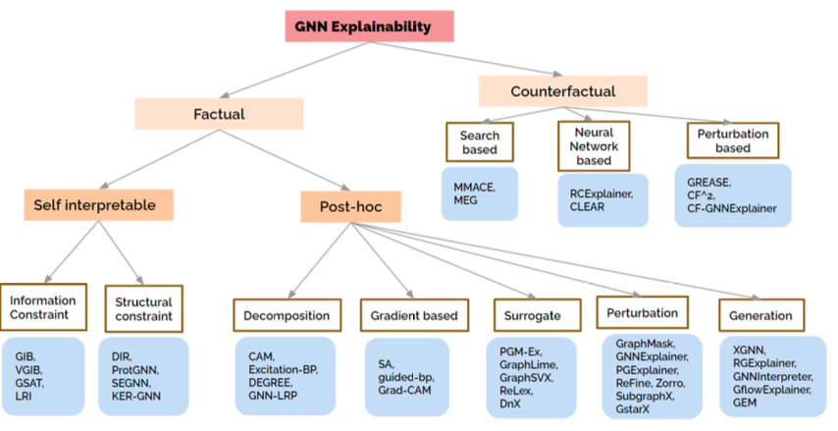
GNN XAI method taxonomy
Image credit: Kakkad et al, https://arxiv.org/abs/2306.01958

Slide 26
GNN XAI method taxonomy
Image credit: Kakkad et al, https://arxiv.org/abs/2306.01958

Slide 27
Factual explanations on graphs
Factual methods form an explanation as a set of input features (e.g., nodes) with the maximum influence on model output
Post-hoc methods
Separate from the prediction model
Use the model input, output, and sometimes model weights
Self-interpretable
Integrated into the model architecture
Usually have two components
Subgraph extraction module that finds the most informative subgraph of the input graph
Prediction module that uses the subgraph to make the prediction

Slide 28
Evaluating factual methods
Assume an explanation method indicates a set of important input features (e.g., nodes)
Fidelity
Idea: removal of important features should reduce model performance
Example: Difference in model prediction accuracy averaged across all classes
Contrastivity
Idea: Important features should differ across possible outcomes
Example: Hamming distance between binarized importance scores on nodes by class
Sparsity
Ideas: explanations should be minimal
Example: the percentage of nodes in the graph identified as important

Slide 29
GNN XAI method taxonomy
Image credit: Kakkad et al, https://arxiv.org/abs/2306.01958

Slide 30
Post-hoc methods
Gradient methods
Motivation: gradient of the prediction with respect to the input represents how sensitive the prediction is to the input
How do we compute the gradients of the prediction for a GNN?

Slide 31
Contrastive gradient saliency maps for GCNs
Consider graph classification task
Goal is to assess node importance
Consider a GNN with
Arbitrary number of graph convolutional layers (GCNs)
Followed by a global mean pooling (GMP) layer
GMP layers input to a classifier (e.g., fully connected output layer)

Slide 32
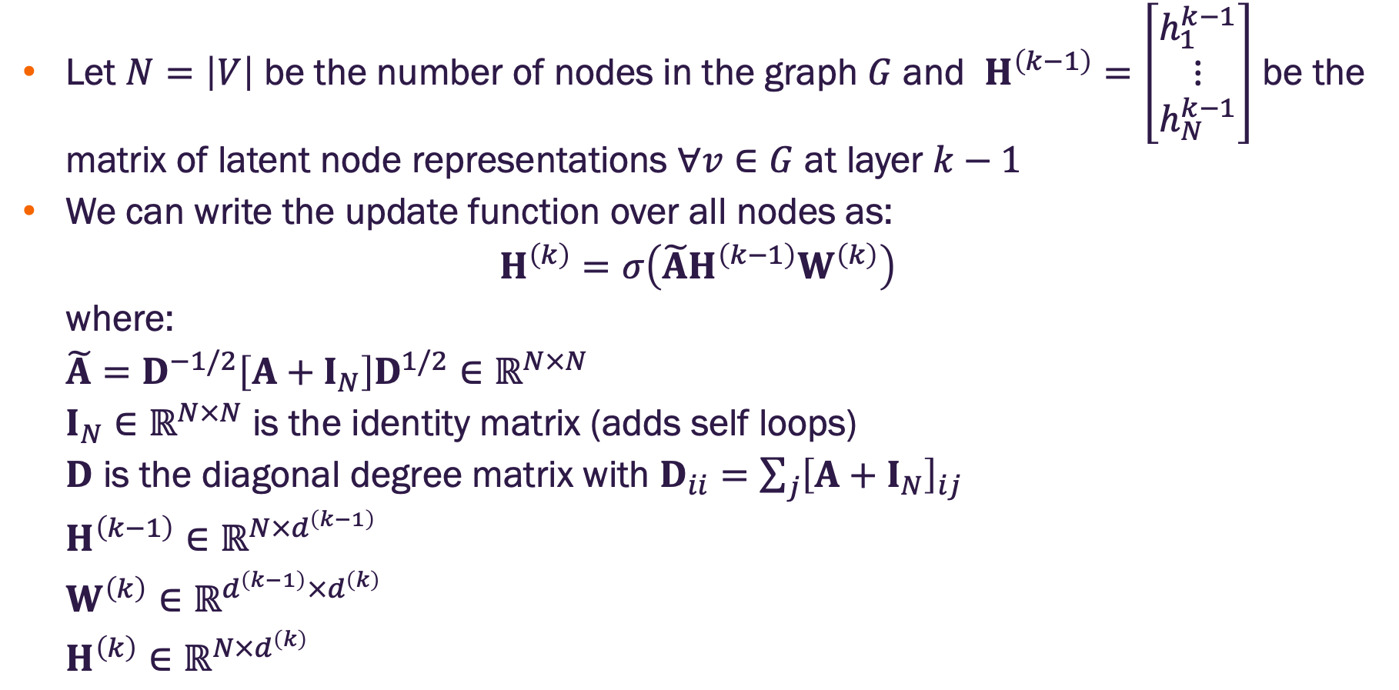
The math of graph convolution networks in matrix form
Let $N=\left|V\right|$ be the number of nodes in the graph $G$ and $H^{\left(k−1\right)}=\left[\begin{aligned}h_{1}^{k−1} \\ \begin{aligned}⋮ \\ h_{N}^{k−1}\end{aligned}\end{aligned}\right]$ be the matrix of latent node representations $∀v∈G$ at layer $k−1$
We can write the update function over all nodes as:
$$H^{\left(k\right)}=σ\left(\tilde{A}H^{\left(k−1\right)}W^{\left(k\right)}\right)$$
where:
$$\tilde{A}=D^{−1/2}\left[A+I_{N}\right]D^{1/2}∈ℝ^{N×N}$$
$I_{N}∈ℝ^{N×N}$ is the identity matrix (adds self loops)
$D$ is the diagonal degree matrix with $D_{ii}=\sum_{j}{{\left[A+I_{N}\right]}_{ij}}$
$$H^{\left(k−1\right)}∈ℝ^{N×d^{\left(k−1\right)}}$$
$$W^{\left(k\right)}∈ℝ^{d^{\left(k−1\right)}×d^{\left(k\right)}}$$
$$H^{\left(k\right)}∈ℝ^{N×d^{\left(k\right)}}$$

Slide 33
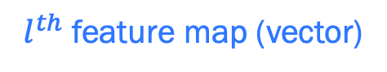
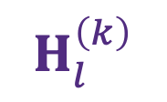
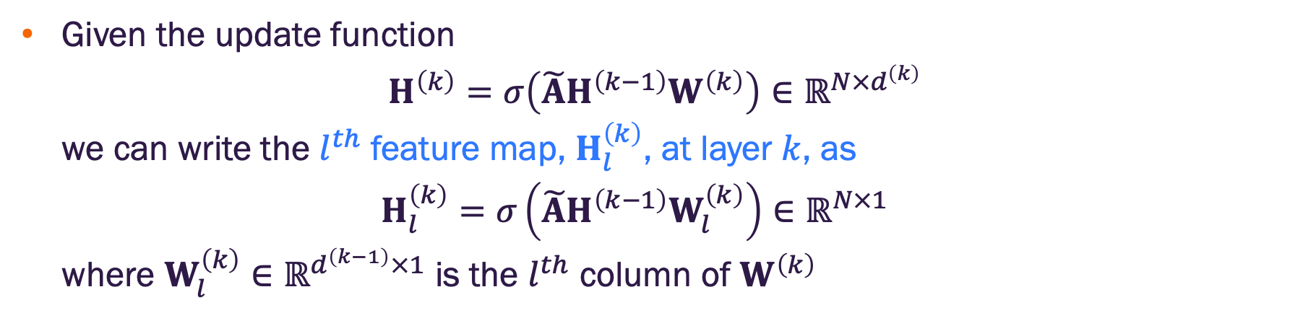
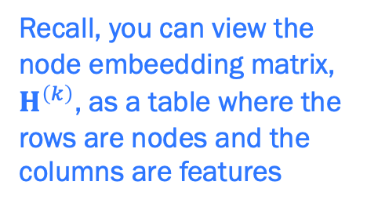
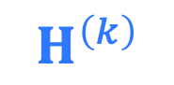
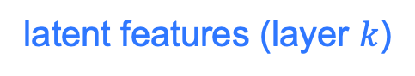
Decomposing the GCN score
Given the update function
$$H^{\left(k\right)}=σ\left(\tilde{A}H^{\left(k−1\right)}W^{\left(k\right)}\right)∈ℝ^{N×d^{\left(k\right)}}$$
we can write the $l^{th}$ feature map, $H_{l}^{\left(k\right)}$, at layer $k$, as
$$H_{l}^{\left(k\right)}=σ\left(\tilde{A}H^{\left(k−1\right)}W_{l}^{\left(k\right)}\right)∈ℝ^{N×1}$$
where $W_{l}^{\left(k\right)}∈ℝ^{d^{\left(k−1\right)}×1}$ is the $l^{th}$ column of $W^{\left(k\right)}$
$l^{th}$ feature map (vector)
$$H_{l}^{\left(k\right)}$$
$$H^{\left(k\right)}$$
Recall, you can view the node embeedding matrix, $H^{\left(k\right)}$, as a table where the rows are nodes and the columns are features
Graph nodes
latent features (layer $k$)

Slide 34

Decomposing the GCN score
Given the update function
$$H^{\left(k\right)}=σ\left(\tilde{A}H^{\left(k−1\right)}W^{\left(k\right)}\right)∈ℝ^{N×d^{\left(k\right)}}$$
we can write the $l^{th}$ feature map, $H_{l}^{\left(k\right)}$, at layer $k$, as
$$H_{l}^{\left(k\right)}=σ\left(\tilde{A}H^{\left(k−1\right)}W_{l}^{\left(k\right)}\right)∈ℝ^{N×1}$$
where $W_{l}^{\left(k\right)}∈ℝ^{d^{\left(k−1\right)}×1}$ is the $l^{th}$ column of $W^{\left(k\right)}$
$l^{th}$ feature map (vector)
$$H_{l}^{\left(k\right)}$$
$$H^{\left(k\right)}$$
Recall, you can view the node embeedding matrix, $H^{\left(k\right)}$, as a table where the rows are nodes and the columns are features
Graph nodes
node $n$ embedding
latent features (layer $k$)

Slide 35
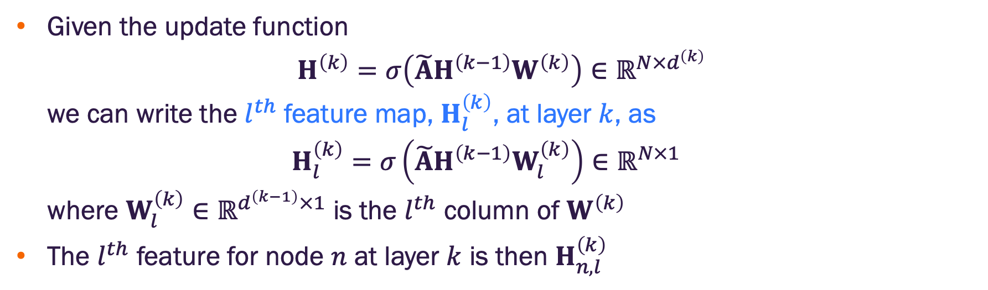
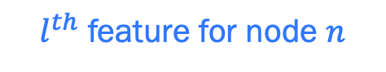
Decomposing the GCN score
Given the update function
$$H^{\left(k\right)}=σ\left(\tilde{A}H^{\left(k−1\right)}W^{\left(k\right)}\right)∈ℝ^{N×d^{\left(k\right)}}$$
we can write the $l^{th}$ feature map, $H_{l}^{\left(k\right)}$, at layer $k$, as
$$H_{l}^{\left(k\right)}=σ\left(\tilde{A}H^{\left(k−1\right)}W_{l}^{\left(k\right)}\right)∈ℝ^{N×1}$$
where $W_{l}^{\left(k\right)}∈ℝ^{d^{\left(k−1\right)}×1}$ is the $l^{th}$ column of $W^{\left(k\right)}$
The $l^{th}$ feature for node $n$ at layer $k$ is then $H_{n,l}^{\left(k\right)}$
$l^{th}$ feature map (vector)
$$H_{l}^{\left(k\right)}$$
$$H^{\left(k\right)}$$
Recall, you can view the node embeedding matrix, $H^{\left(k\right)}$, as a table where the rows are nodes and the columns are features
$l^{th}$ feature for node $n$
Graph nodes
node $n$ embedding
latent features (layer $k$)

Slide 36
Contrastive gradient saliency maps for GCNs
Consider graph classification task
Goal is to assess node importance
Consider a GNN with
Arbitrary number of graph convolutional layers (GCNs)
Followed by a global mean pooling (GMP) layer
GMP layers input to a classifier (e.g., fully connected output layer)

Slide 37
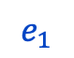
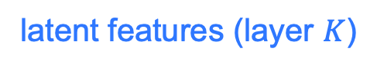
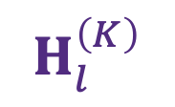
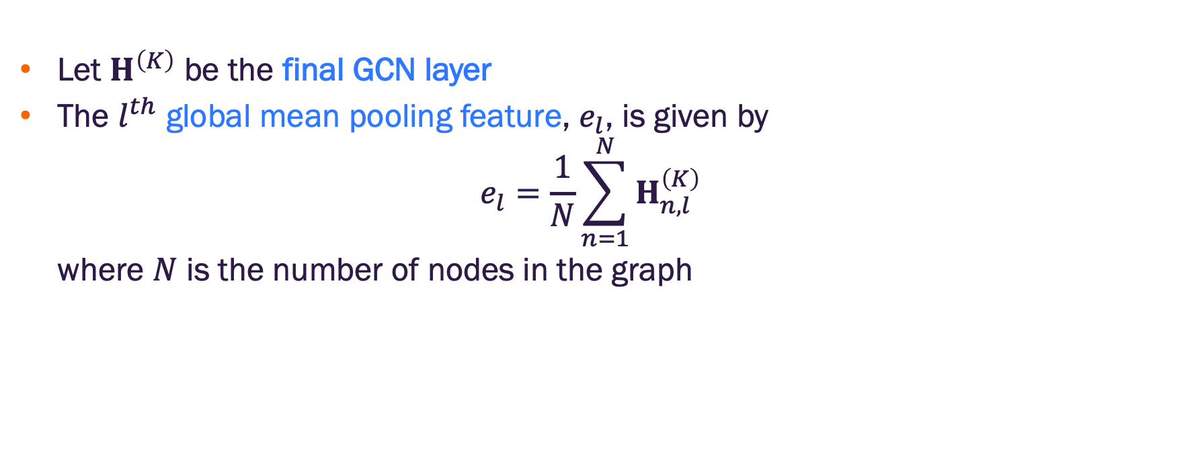
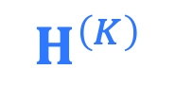
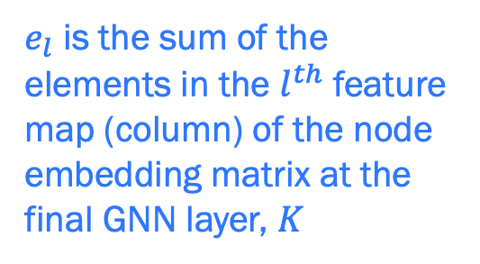
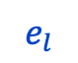
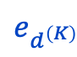
Decomposing the GCN score
Let $H^{\left(K\right)}$ be the final GCN layer
The $l^{th}$ global mean pooling feature, $e_{l}$, is given by
$$e_{l}=\frac{1}{N}\sum_{n=1}^{N}{H_{n,l}^{\left(K\right)}}$$
where $N$ is the number of nodes in the graph
$$e_{1}$$
$$e_{l}$$
$$e_{d^{\left(K\right)}}$$
$e_{l}$ is the sum of the elements in the $l^{th}$ feature map (column) of the node embedding matrix at the final GNN layer, $K$
⨊
$$H_{l}^{\left(K\right)}$$
$$H^{\left(K\right)}$$
Graph nodes
node $n$ embedding
latent features (layer $K$)

Slide 38
Contrastive gradient saliency maps for GCNs
Consider graph classification task
Goal is to assess node importance
Consider a GNN with
Arbitrary number of graph convolutional layers (GCNs)
Followed by a global mean pooling (GMP) layer
GMP layers input to a classifier (e.g., fully connected output layer)

Slide 39
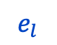
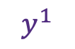
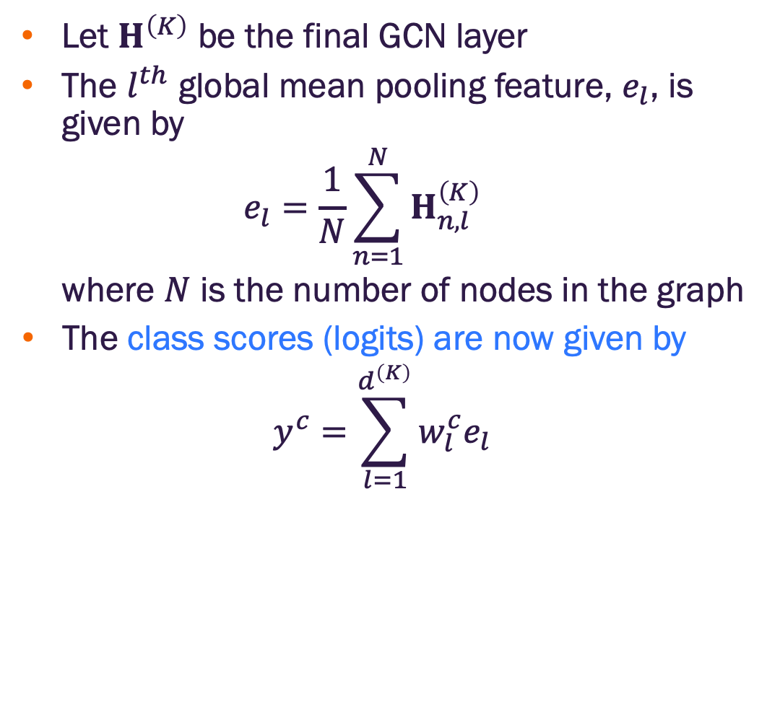
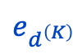
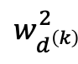
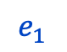
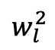
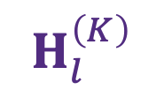
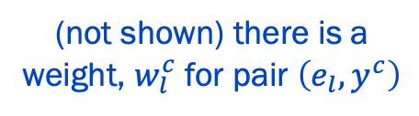
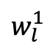
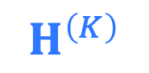
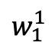
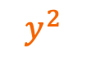
Decomposing the GCN score
Let $H^{\left(K\right)}$ be the final GCN layer
The $l^{th}$ global mean pooling feature, $e_{l}$, is given by
$$e_{l}=\frac{1}{N}\sum_{n=1}^{N}{H_{n,l}^{\left(K\right)}}$$
where $N$ is the number of nodes in the graph
The class scores (logits) are now given by
$$y^{c}=\sum_{l=1}^{d^{\left(K\right)}}{w_{l}^{c}e_{l}}$$
$$H_{l}^{\left(K\right)}$$
$$H^{\left(K\right)}$$
⨊
$$e_{1}$$
$$e_{l}$$
$$e_{d^{\left(K\right)}}$$
$$w_{l}^{1}$$
$$w_{l}^{2}$$
$$w_{d^{\left(k\right)}}^{2}$$
$$w_{1}^{1}$$
(not shown) there is a weight, $w_{l}^{c}$ for pair $\left(e_{l},y^{c}\right)$
$$y^{1}$$
$$y^{2}$$
class 1
class 2

Slide 40
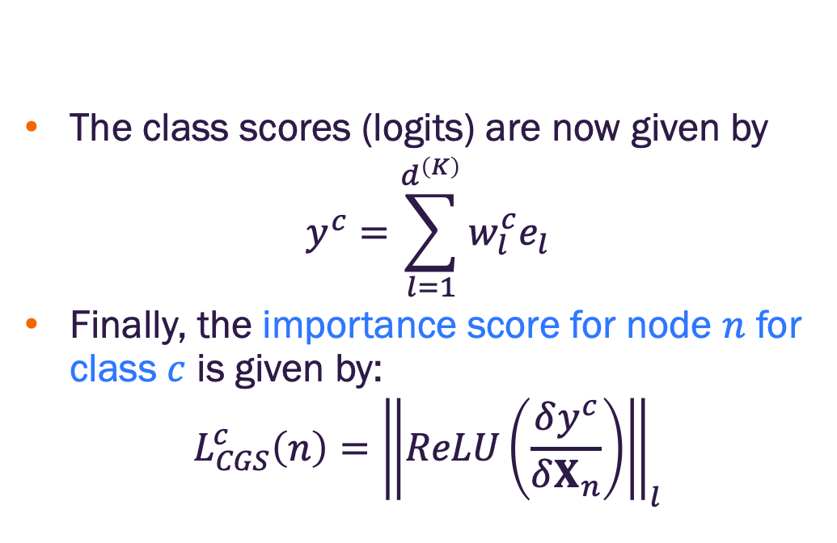
Contrastive gradient saliency maps for GCNs
The class scores (logits) are now given by
$$y^{c}=\sum_{l=1}^{d^{\left(K\right)}}{w_{l}^{c}e_{l}}$$
Finally, the importance score for node $n$ for class $c$ is given by:
$$L_{CGS}^{c}\left(n\right)={\left\|ReLU\left(\frac{δy^{c}}{δX_{n}}\right)\right\|}_{l}$$
$$H_{l}^{\left(K\right)}$$
$$H^{\left(K\right)}$$
⨊
$$e_{1}$$
$$e_{l}$$
$$e_{d^{\left(K\right)}}$$
$$w_{l}^{1}$$
$$w_{l}^{2}$$
$$w_{d^{\left(k\right)}}^{2}$$
$$w_{1}^{1}$$
(not shown) there is a weight, $w_{l}^{c}$ for pair $\left(e_{l},y^{c}\right)$
$$y^{1}$$
$$y^{2}$$
class 1
class 2

Slide 41

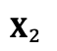
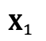








Contrastive gradient saliency maps for GCNs
The node importance scores can be visualized as a node heat map
high importance
low importance
$$X_{2}$$
$$X_{2}$$
$$L_{CGS}^{c}\left(n\right)={\left\|ReLU\left(\frac{δy^{c}}{δX_{n}}\right)\right\|}_{l}$$
class 1 importance
$$X_{1}$$
$$X_{3}$$
$$X_{1}$$
$$X_{3}$$
$$X_{2}$$
class 2 importance
$$X_{1}$$
$$X_{3}$$

Slide 42
Summary of contrastive gradient saliency maps for GCNs
The node importance score is taken to be the gradient (partial derivative) of the class probability prediction with respect to the node input features
Many limitations
Low fidelity: Very sensitive to small perturbations that don’t change class prediction
Low sparsity: Often indicates high importance for many nodes in the graph
Low constrastivity: Often indicates the same nodes are important for every class

Slide 43
GNN XAI method taxonomy
Image credit: Kakkad et al, https://arxiv.org/abs/2306.01958

Slide 44
Post-hoc methods
Decomposition methods
Treat model predictions as a score that can be decomposed and distributed across model component all the way back to the input
The portion of the score allocated to a component is its importance
Methods vary by the way in which the score is decomposed
White-box: all such methods require access to the model weights
How should we decompose the GNN output score?

Slide 45

Decomposing the GCN score
Let $H^{\left(K\right)}$ be the final GCN layer
The $l^{th}$ global mean pooling feature, $e_{l}$, is given by
$$e_{l}=\frac{1}{N}\sum_{n=1}^{N}{H_{n,l}^{\left(K\right)}}$$
where $N$ is the number of nodes in the graph
The class scores (logits) are now given by
$$y^{c}=\sum_{l=1}^{d^{\left(K\right)}}{w_{l}^{c}e_{l}}$$
$$H_{l}^{\left(K\right)}$$
$$H^{\left(K\right)}$$
⨊
$$e_{1}$$
$$e_{l}$$
$$e_{d^{\left(K\right)}}$$
$$w_{l}^{1}$$
$$w_{l}^{2}$$
$$w_{d^{\left(k\right)}}^{2}$$
$$w_{1}^{1}$$
(not shown) there is a weight, $w_{l}^{c}$ for pair $\left(e_{l},y^{c}\right)$
$$y^{1}$$
$$y^{2}$$
class 1
class 2

Slide 46


Class activation maps (CAM)
Consider the $l^{th}$ feature map at the final GCN layer, $K$
$$H_{l}^{\left(K\right)}=σ\left(\tilde{A}H^{\left(k−1\right)}W_{l}^{\left(K\right)}\right)∈ℝ^{N×1}$$
The CAM importance score for node $n$ for class $c$ is given by the final node embedding scaled by the output layer weights:
$$L_{CAM}^{c}\left(n\right)=ReLU\left(\sum_{l=1}^{d^{\left(K\right)}}{w_{l}^{c}H_{n,l}^{\left(K\right)}}\right)$$
$$H_{l}^{\left(K\right)}$$
$$H^{\left(K\right)}$$
$$H_{n,l}^{\left(k\right)}$$
⨊
$$e_{1}$$
$$e_{l}$$
$$e_{d^{\left(K\right)}}$$
$$w_{l}^{1}$$
$$w_{l}^{2}$$
$$w_{d^{\left(k\right)}}^{2}$$
$$w_{1}^{1}$$
(not shown) there is a weight, $w_{l}^{c}$ for pair $\left(e_{l},y^{c}\right)$
$$y^{1}$$
$$y^{2}$$
class 1
class 2

Slide 47
Summary of class activation maps (CAM) for GCN
CAM scoring represents the contribution of the final node “feature map” (embedding) to the class score
Typically displayed as a node heat map
Strengths
High contrastivity: often results in different node importance across different classes
High fidelity: often results in identifying nodes, that if removed, reduce model accuracy
Limitations
Low sparsity: often identifies many nodes as important which may be problematic on large graphs

Slide 48
GNN XAI method taxonomy
Image credit: Kakkad et al, https://arxiv.org/abs/2306.01958

Slide 49
What about layers before the final layer?
Both the contrastive gradient and class activation map methods consider importance based on the final node embedding layer
This can inform
Hierarchical feature learning
Do lower layers focus on local structure?
Do higher layers capture larger node groups?
Model debugging
Many nodes important at early layers
Node importance doesn’t change across layers

Slide 50
Grad-CAM
Consider the $l^{th}$ feature map at the final GCN layer, $K$
$$H_{l}^{\left(K\right)}=σ\left(\tilde{A}H^{\left(k−1\right)}W_{l}^{\left(K\right)}\right)∈ℝ^{N×1}$$
The CAM importance score for node $n$ for class $c$ is given by the final node embedding scaled by the output layer weights:
$$L_{CAM}^{c}\left(n\right)=ReLU\left(\sum_{l=1}^{d^{\left(K\right)}}{w_{l}^{c}H_{n,l}^{\left(K\right)}}\right)$$
$$H_{l}^{\left(K\right)}$$
$$H^{\left(K\right)}$$
$$H_{n,l}^{\left(k\right)}$$
⨊
$$e_{1}$$
$$e_{l}$$
$$e_{d^{\left(K\right)}}$$
$$w_{l}^{1}$$
$$w_{l}^{2}$$
$$w_{d^{\left(k\right)}}^{2}$$
$$w_{1}^{1}$$
(not shown) there is a weight, $w_{l}^{c}$ for pair $\left(e_{l},y^{c}\right)$
$$y^{1}$$
$$y^{2}$$
class 1
class 2

Slide 51

Grad-CAM
Recall, the GNN score was decomposed as
$$y^{c}=\sum_{l=1}^{d^{\left(K\right)}}{w_{l}^{c}e_{l}}=\frac{1}{N}\sum_{l=1}^{d^{\left(K\right)}}{w_{l}^{c}\sum_{n=1}^{N}{H_{n,l}^{\left(K\right)}}}$$
$$H_{l}^{\left(K\right)}$$
$$H^{\left(K\right)}$$
$$H_{n,l}^{\left(k\right)}$$
⨊
$$e_{1}$$
$$e_{l}$$
$$e_{d^{\left(K\right)}}$$
$$w_{l}^{1}$$
$$w_{l}^{2}$$
$$w_{d^{\left(k\right)}}^{2}$$
$$w_{1}^{1}$$
$$y^{1}$$
$$y^{2}$$
class 1
class 2

Slide 52


Grad-CAM
Recall, the GNN score was decomposed as
$$y^{c}=\sum_{l=1}^{d^{\left(K\right)}}{w_{l}^{c}e_{l}}=\frac{1}{N}\sum_{l=1}^{d^{\left(K\right)}}{w_{l}^{c}\sum_{n=1}^{N}{H_{n,l}^{\left(K\right)}}}$$
Define class, $c$, and layer, $k$, specific weights for the $l^{th}$ feature (node embedding space)
$$α_{l}^{k,c}=\frac{1}{N}\sum_{n=1}^{N}{\frac{δy^{c}}{δH_{n,l}^{\left(k\right)}}}$$
$$H_{l}^{\left(K\right)}$$
$$H^{\left(K\right)}$$
$$H_{n,l}^{\left(k\right)}$$
⨊
sensitivity of class probability logit to changes in the node’s $l^{th}$feature value at layer $k$
$$e_{1}$$
$$e_{l}$$
$$e_{d^{\left(K\right)}}$$
$$w_{l}^{1}$$
$$w_{l}^{2}$$
$$w_{d^{\left(k\right)}}^{2}$$
$$w_{1}^{1}$$
$$y^{1}$$
$$y^{2}$$
class 1
class 2

Slide 53


Grad-CAM
Recall, the GNN score was decomposed as
$$y^{c}=\sum_{l=1}^{d^{\left(K\right)}}{w_{l}^{c}e_{l}}=\frac{1}{N}\sum_{l=1}^{d^{\left(K\right)}}{w_{l}^{c}\sum_{n=1}^{N}{H_{n,l}^{\left(K\right)}}}$$
Define class, $c$, and layer, $k$, specific weights for the $l^{th}$ feature (node embedding space)
$$α_{l}^{k,c}=\frac{1}{N}\sum_{n=1}^{N}{\frac{δy^{c}}{δH_{n,l}^{\left(k\right)}}}$$
The importance score for node $n$ at layer $k$ is
$$L_{GradCAM}^{c}\left(k,n\right)=ReLU\left(\sum_{l=1}^{d^{\left(k\right)}}{α_{l}^{k,c}}H_{n,l}^{\left(k\right)}\right)$$
$$H_{l}^{\left(K\right)}$$
$$H^{\left(K\right)}$$
$$H_{n,l}^{\left(k\right)}$$
⨊
$$e_{1}$$
$$e_{l}$$
$$e_{d^{\left(K\right)}}$$
$$w_{l}^{1}$$
$$w_{l}^{2}$$
$$w_{d^{\left(k\right)}}^{2}$$
$$w_{1}^{1}$$
sum of the value of node’s $l^{th}$feature value at layer $k$ weighted by sensitivity of output to changes in the feature
$$y^{1}$$
$$y^{2}$$
class 1
class 2

Slide 54
Summary of Grad-CAM for GCN
Grad-CAM scoring represents the contribution of a nodes “feature map” (embedding) at a given layer to the class score
Grad-CAM at the final layer is equivalent to CAM
Typically display heat map for final layer, with analysis at lower layer for detailed interpretations / model debugging
Strengths
Same as CAM for final layer (high constrastivity, fidelity)
Enables layer wise analysis for debugging, finer grain interpretation of feature importance
Limitations
Low sparsity at final layer (same as CAM)

Slide 55
GNN XAI method taxonomy
Image credit: Kakkad et al, https://arxiv.org/abs/2306.01958

Slide 56


Surrogate methods for explaining GNNs
Fit an interpretable surrogate model in the locality of the prediction
Given a graph $G$ and a prediction on input $x$ (i.e., a node or edge) generate predictions near $x$ and record model predictions
Train the surrogate model and interpret important features
Image credit: Kakkad et al, https://arxiv.org/abs/2306.01958

Slide 57


Perturbation methods for explaining GNNs
Identify important subgraphs (i.e. node and edge subsets) by perturbing the input graph
Two general steps
For an input graph $G$, extraction module identifies a subgraph $G_{s}$
Model prediction $y_{s}$ on the subgraph compared to score $y$
Training teaches extraction model to find subgraphs $G_{s}$ that
minimize difference between $y_{s}$ and $y$
maintain sparsity of $G_{s}$
Image credit: Kakkad et al, https://arxiv.org/abs/2306.01958

Slide 58
Generation methods for explaining GNNs
Apply generative methods to derive explanations
Model level generative explanations
Generate sub-graph patterns that maximize predictions for a certain class
The sub-graphs are the explanations
Instance level (particular graph / node classification) explanations
Generate a sub-graph conditioned on the input graph that maintains the prediction (similar to perturbation methods but differ in how the sub-graph is generated)
Image credit: Kakkad et al, https://arxiv.org/abs/2306.01958

Slide 59
GNN XAI method taxonomy
Image credit: Kakkad et al, https://arxiv.org/abs/2306.01958

Slide 60
Counterfactual explanations on GNNs
Find the minimum changes (counterfactual) to the input graph that change the model prediction
Types of counterfactual methods include:
Perturbation
Neural network
Search
See, https://arxiv.org/abs/2306.01958, for review
Image credit: Kakkad et al, https://arxiv.org/abs/2306.01958

Slide 61
XAI in PyG

Slide 62

PyG Explainer
Assume we have a trained GNN model
Assume we’ve selected an explanation algorithm
PyG Explainer is a wrapper class that implements the algorithm
Forward method returns and Explanation object
Consists of node and edge masks (the explanation)

Slide 63

PyG Explainer Algorithms
Several built in explanation algorithms

Slide 64

PyG Explanation Metrics
Several built in metrics

Slide 65
Python XAI resources
SHAP - https://shap.readthedocs.io/en/latest/
ELI5 - https://eli5.readthedocs.io/en/latest/
Captum - https://captum.ai/ (deep learning XAI library)
Interpretable Machine Learning by Molnar (free online text) https://christophm.github.io/interpretable-ml-book/

Slide 66


